Slide 1

Elise Joulain
Tobias Bodenmann
Arnault Monoyer
Matthieu Sayar

Slide 2
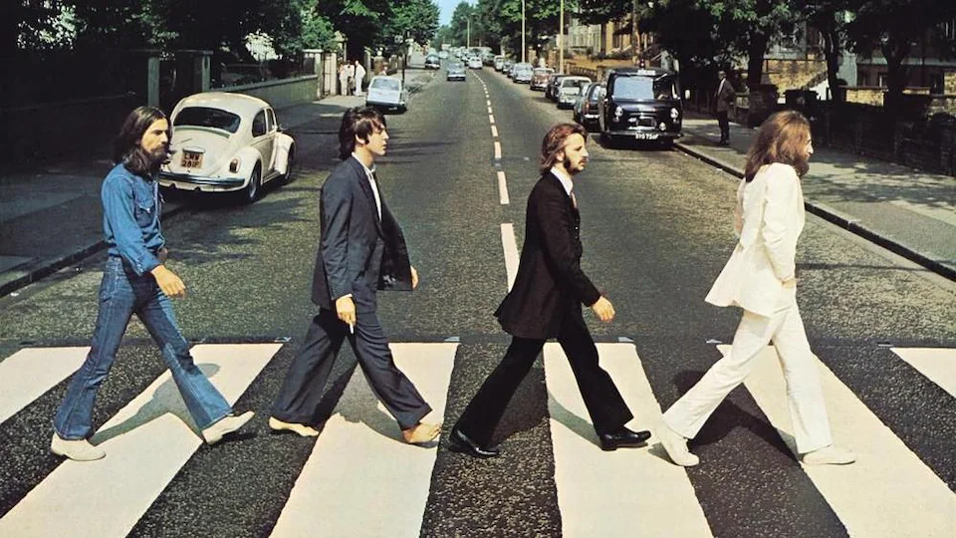
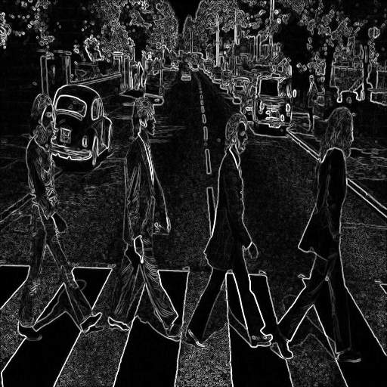
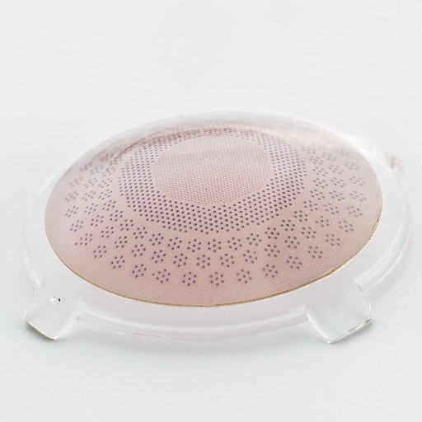
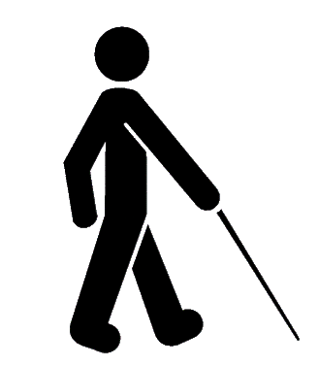
A new way to see the world !
redinal.ch

Slide 3




Field Overview
Population
Lack of solutions
50,000 blind persons in Switzerland
2.6 Mio in Europe
49 Mio in the world
Too few discrete and viable solutions offered to the blind to restore vision with a minimal resolution
Compatible population
Market penetrance
Up to 60% of the blind
20% market share → 6,000 (312,000) predicted patients in CH (Europe)
Triple by 2050
redinal.ch

Slide 4




Technical background
Epi-retinal implant
True-wireless device
Non damaging fixation to the retina
Signal amplification and processing through an integrated microchip
No additional device
Photovoltaic cells
Bio-compatible materials
Electrode array excitable through Infrared light
Flexible bio-compatible materials with low manufacturing cost
redinal.ch

Slide 5
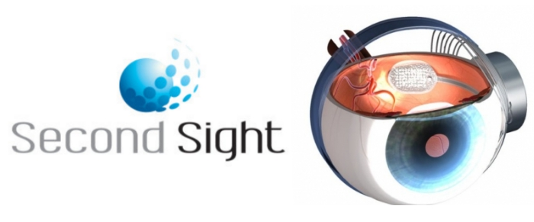



 | Argus II | Iris ii | prima | Redinal
True-wireless device​
All integrated implant
IR input signal
Quick surgery
Photovoltaic cells
Number of electrodes | 60 | 150 | 378 | 10,500
Relative acuity score | + | + | ++ | ++++
Lifetime (years) | 10 | 3 | ? | 2
Price per year (total) | 15,000 (150,000) | 30,000 (90,000) | ? | 10,000 (20,000)

Slide 6
Swiss Market opportunity overview
CHF 7.3b
CHF 21k
CHF 10k
Total cost of visual impairment
Medical and social direct costs
Indirect well-being costs
QALYs costs
Financial consequences per blind per year
Societal willingness to pay per blind per year for an implant
redinal.ch

Slide 7

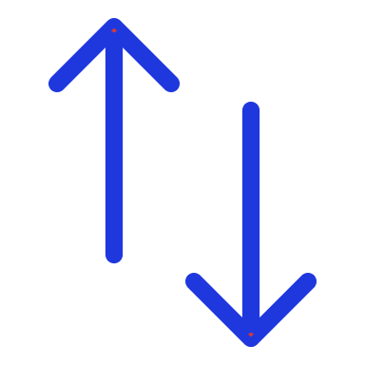



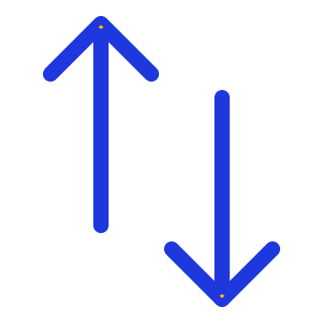
Surgical training
Retinal Implant
Anonymized data
Feedback
50%
20K CHF
Surgery
redinal.ch

Slide 8
Competitors’
Patents
Electrodes
Fixation
Materials
EP2408514A2:
Active retinal implant
US8150526B2:
Retinal prosthesis
EP2158937A3:
Artificial retina device
US2021162213A1:
Retinal implant fixation
WO2019211847A1:
Retinal implant fixation apparatus and techniques
WO2005082049A2:
Artificial biocompatible material
FTO approved
by PRINS Intellectual Property AG in Zurich
redinal.ch

Slide 9
Redinal’s
Patents
Owned
FUTURE
WO2018177547(A1):
Polymer-based optoelectronic
WO2018103828(A1):
Implantable electrode and method for manufacturing
Implantation device
Second generation technology
redinal.ch

Slide 10
Beginning of the clinical trials
In Switzerland for 2021 in collaboration with European Vision Institute.
End of the clinical trial
EMA Approval of the device
commercialization
TRL 9
ISO 20916 and ISO 13485
Proof of concept
Working prosthesis for rabbits
→ MVP
TRL 3
First Implant renewals
10
2009
2014
2019
2021
2023
2024
2026
2027
Idea
Why not use photovoltaic pixels for retinal needs ?
Pre-clinical trials
Mass manufacturing
small scale commercialization < 50 customers (NuroKor Bioelectronics)
Second generation product development
MMP
TRL 4/5
Proper functioning prosthesis for rabbits
TRL 5/6
redinal.ch

Slide 11
Pre-launch finances
11.3M CHF
14.4M CHF
redinal.ch

Slide 12
Since 2019
Product development and outsourcing
Pre-clinical trials
IP/Regulation
4.4M CHF
redinal.ch

Slide 13
Today
Recruiting
Clinical trials
Patents
Launch
10M CHF
redinal.ch

Slide 15
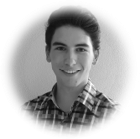
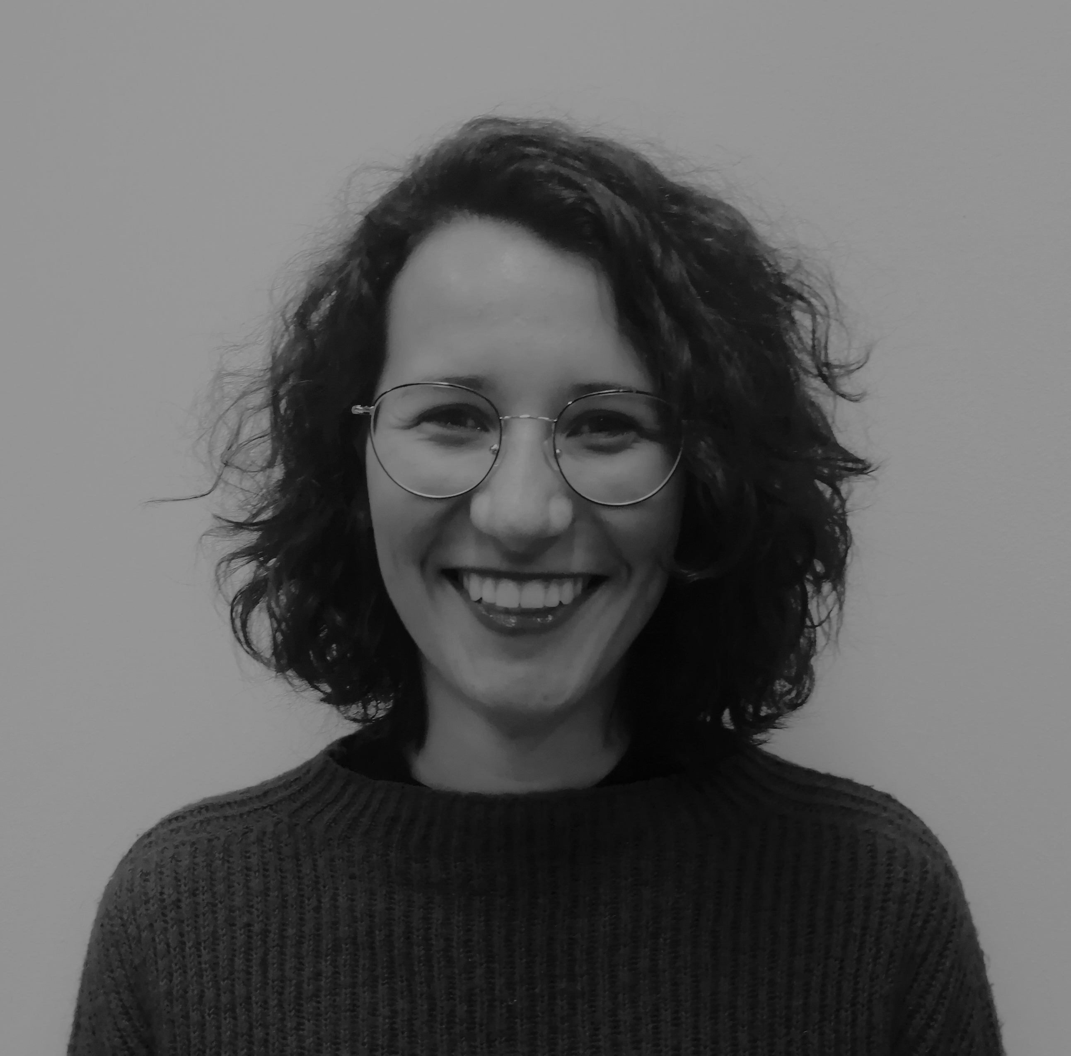
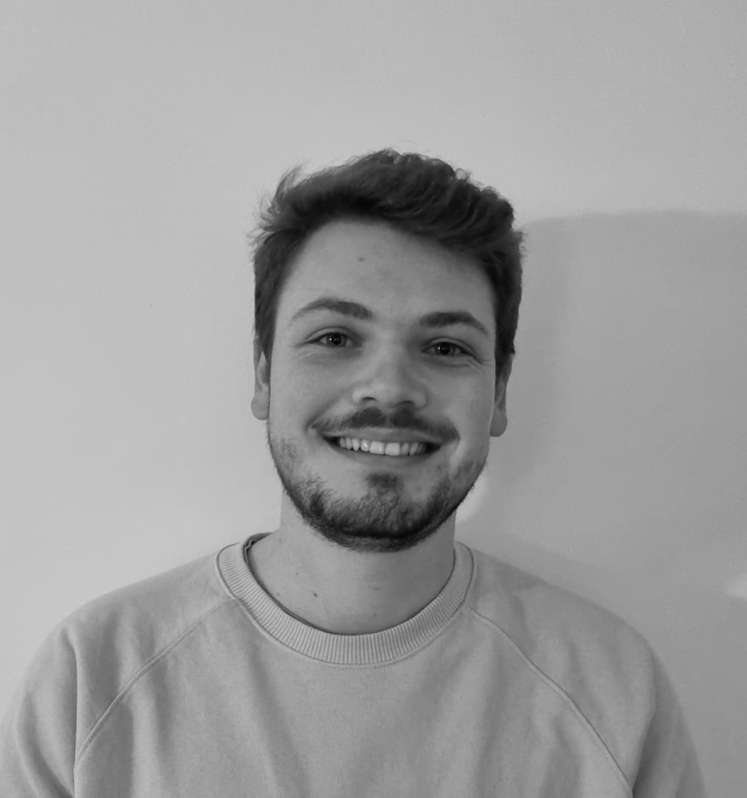
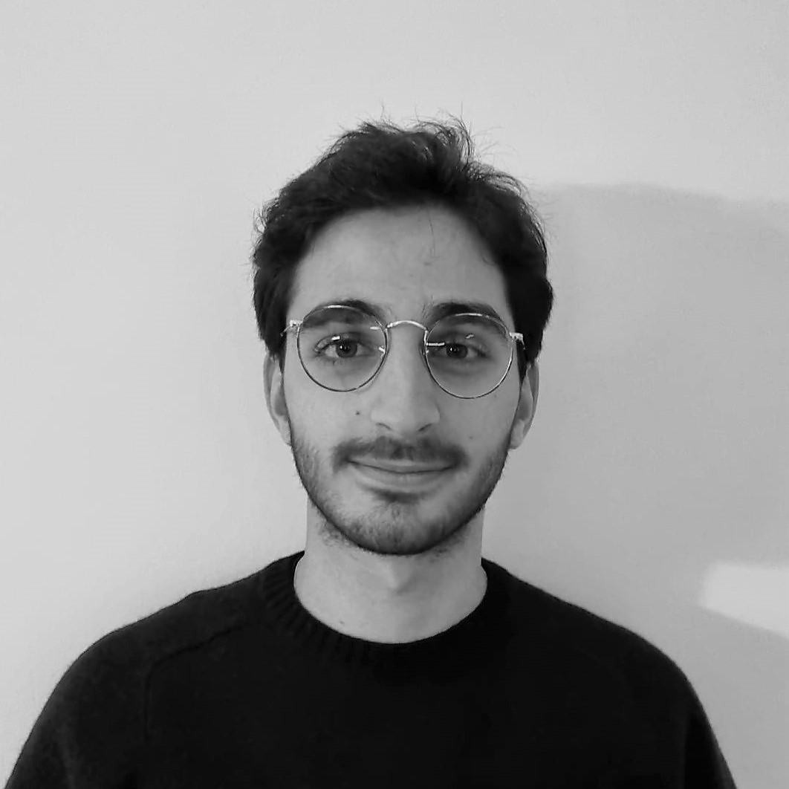

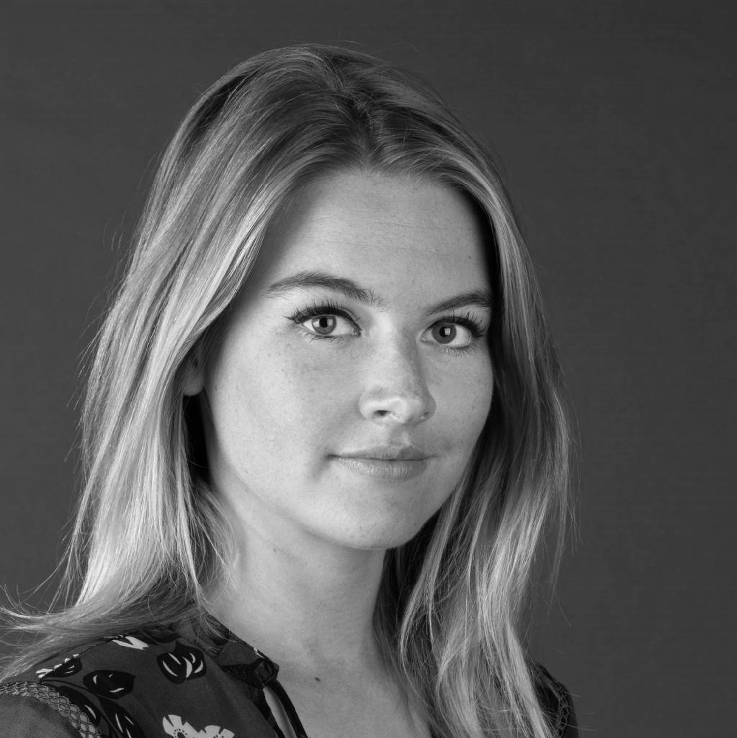
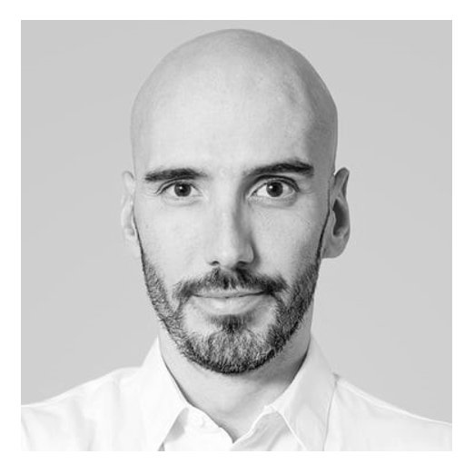
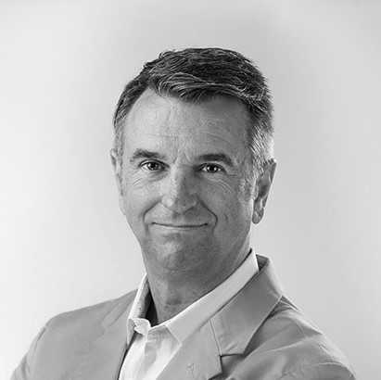
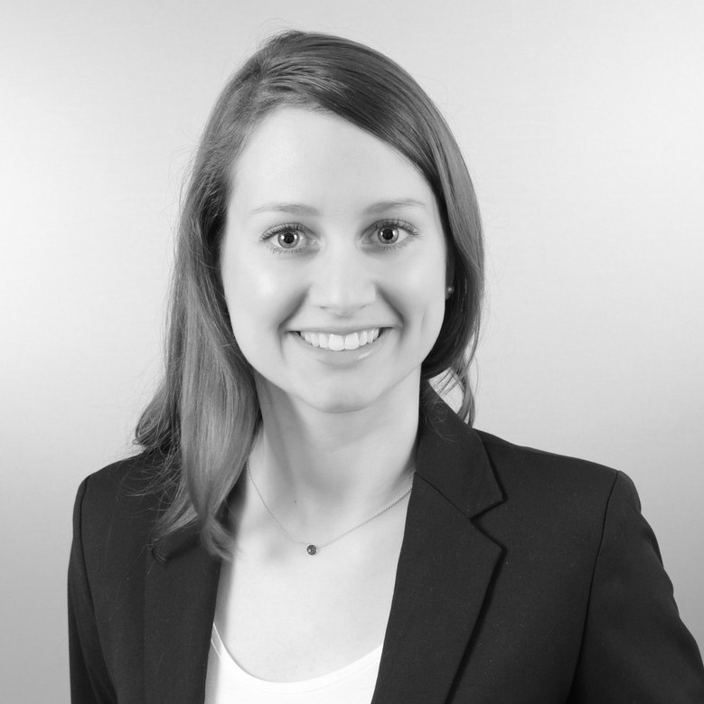
OUR TEAM
Tobias - CEO
Neuroprosthetics
Electronics
Elise - CTO
Biomedical technologies
Biomaterials
Arnault - CFO
Neuroscience
Finance
Sponsoring
Matthieu - COO
Neuroprosthetics
Biology
External help
Scientific advisors
Ophthalmic surgeon consultant
Mass manufacturer Trustee (accounting) Patent attorney
Legal consultant
Marie
Technician
William
Technician
Julius
Regulatory affairs
Alessandra
Marketing
redinal.ch

Slide 16
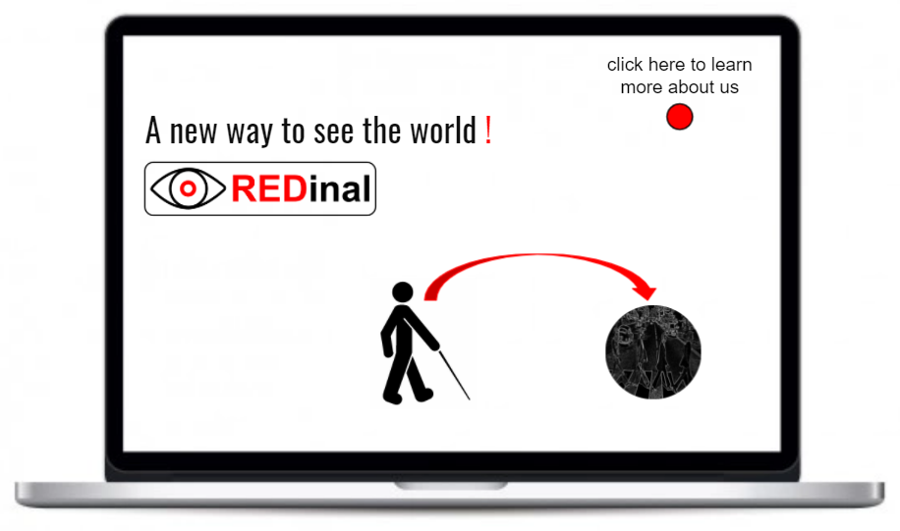


Thank you for your attention!
redinal.ch
contact@redinal.ch
You can find us on:

Slide 19
Field Overview
60% curable -> intact optic nerve needed
  Cure retinitis pigmentosa (RP) and age-related macular degenertation (AMD)
1 out of 2 blind people expected to get implant
Estimate to reach 40% of the remaining patients
(…) estimates that global blindness will triple by the year 2050 (…) it projects that cases of blindness will increase from 36 million to 115 million by 2050. (The Lancet Global Health)

Slide 20
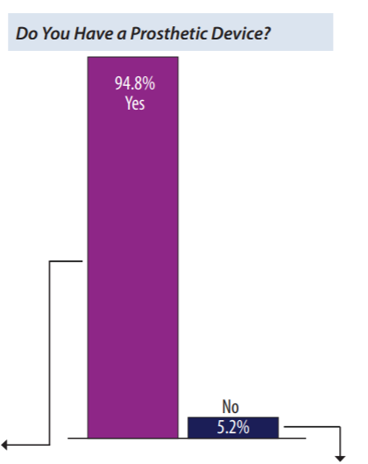
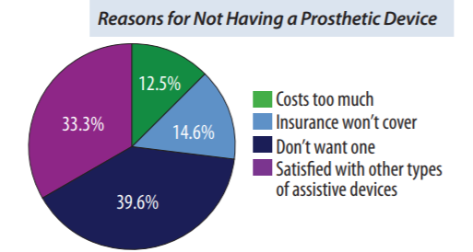
Source : Amputee patient comfort and compliance (https://www.amputee-coalition.org/wp-content/uploads/2015/06/lsp_opedge-survey-article_120115-113042.pdf)

Slide 21
Important Numbers
50 000 blind people (CH) --> 30 000 of curable patient (60%)
Economic burden in the USA : 139 billions USD for 2,6 million visually impared including 1 million blind people without considering QALYs and DALYs
Blind individual vision cost per year = 26 900 USD (71,7 billion USD)
Government payement = 47,4 billion USD
Private insurance = 22,1 billion USD
Indirect cost = 72,2 billion USD (see what percentage we can reduce)
The cost for guide dogs per year (62 million USD) will disappear with regain of autonomy
Medical cost per person = 7000 USD
Productivity loss = 12,5 billion USD
Nursing home Cost = 7,5 billion USD

Slide 22
Important number in Switzerland
Direct costs (medical and social) = 800 million CHF
Indirect costs = 1,5 billion CHF
Economic burden of QALYs = 5 billion CHF 21 years of blindness with a weight of ⅓ (Average age = 62 to life expectancy = 83) 7 QALYs
Financial consequences = 21 000 CHF per blind per year
The Probabilistic Incremental Cost-Effectiveness Ratio (ICER) was estimated to be 28 588 Euros per QALY for ARGUS II our main competitor
3 years of blindness = societal willingness to pay 30 500 CHF in Europe

Slide 23
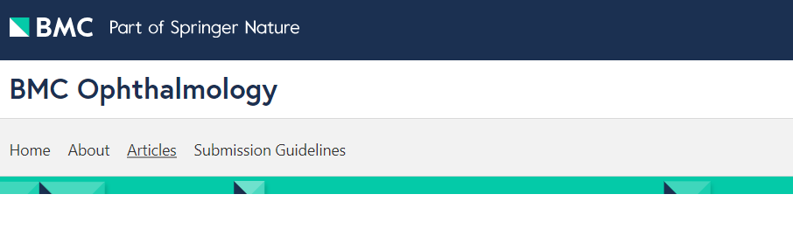
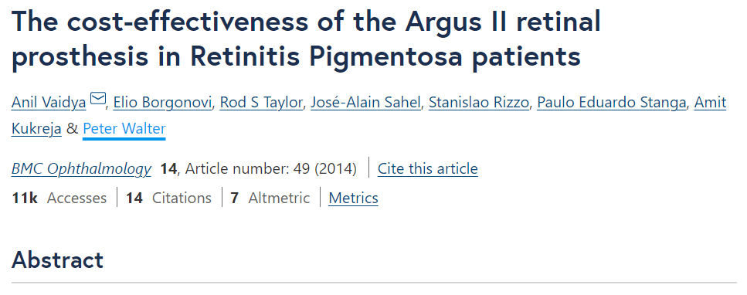

Slide 24
EP2408514A2:
Active retinal implant
US8150526B2
Retinal prosthesis
Subretinal electrode array
Extra-ocular device needed to process the signal and transmit it through a wire
Subretinal electrode array
Extra-ocular mount with transmittor and processors for treatment of the signal

Slide 25
EP2158937A3
Artificial retina device
US2021162213A1
Retinal implant fixation
Date of filing: 01 May 2001
Fixation damaging retina because of a rigid implant

Slide 26
WO2019211847A1
Retinal implant fixation apparatus and techniques
WO2005082049A2
Artificial biocompatible material
Implants separated in two part: epiretinal and an anchor in the ciliary bodies of the eye damaging the eye
Cellulose single layer with pores and cell growth substrate for promotion of repair
Subretinal space

Slide 27
Concept of the design and technology
Organic PVs technologies. OPV cells approved and tested by our laboratory.
TRL 2
Final technology
Proper functioning prosthesis for humans → MMP
Virtual Reality simulation
Expected vision
2009
2011
2014
2015
2019
2020
2021
Idea
Why not use photovoltaic pixels for retinal needs ?
Proof of concept
Working prosthesis for rabbits → MVP
TRL 3
Pre-clinical trials
Beginning of the clinical trials
In Switzerland for 2021 in collaboration with European Vision Institute.
Proper functioning prosthesis for rabbits
TRL 4 and 5

Slide 28
End of the clinical trial
EMA Approval of the device
commercialization
TRL 9
ISO 20916 and ISO 13485
First Implant renewals
Second generation pre-clinical trials
Second generation clinical trials
2023
2024
2026
2027
2029
2030
2031
2035
Mass manufacturing
small scale commercialisation < 50 customers (NuroKor Bioelectronics)
Second generation product development
MMP
TRL 4/5
Expansion
Europe
Second generation commercialization 30% Market Share in Europe

